Slide 1

Understanding Personality Development

Slide 2
Agenda
Introduction to Personality Development
Theories of Personality Development
Emotional Wellbeing
Social Skills and Relationships
Academic and Professional Success
Self Awareness and Personal Growth
Cultural and Ethical Understanding
Adaptability and Flexibility
Leadership Skills
Life Satisfaction and Happiness
Components of Emotional Intelligence
Building Resilience
Activities for Personality Development
Conclusion

Slide 3
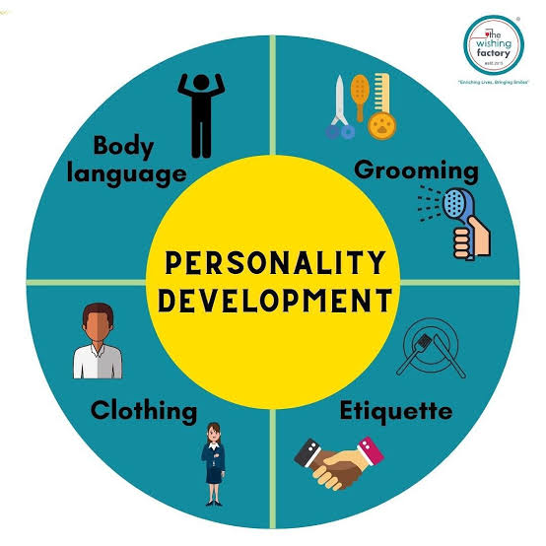
Introduction to Personality Development
Overview
Personality development refers to the process of enhancing one's emotional, social, and cognitive capabilities. It is essential in education as it fosters students' emotional and social growth. Understanding personality development theories enables teachers to support their students more effectively, creating an environment conducive to personal and academic success.

Slide 4

Theories of Personality Development
Theories
Plus tip:
Consider adding specific examples of each theory's application in educational settings.
Overview of Personality Development
Key Theorist: Sigmund Freud
Personality development encompasses various theories that explain how individuals grow and change throughout their lives.
Freud's psychosexual stages of development emphasize the influence of unconscious desires and childhood experiences on personality.
Key Theorist: Erik Erikson
Key Theorist: Carl Rogers
Erikson proposed eight stages of psychosocial development, each characterized by a specific conflict that must be resolved for healthy personality growth.
Rogers introduced the concept of self-actualization, emphasizing the importance of self-awareness and personal growth in developing a healthy personality.

Slide 5

Empowering Mankind
MySkill - Empowering womanhood, is program with a vision to give a platform to all the women for diversifying their existing skills to meet today's challenges. MySkill aims at building actual competencies to achieve their highest desired level of independence and inclusion in their communities.
MySkill has partnered with institutes who have a proven track record of training and empowering women through various educational and experiential learning in the past.
MySkill offers a platform for all aspiring women who want to have a greater expansion in professional and personal growth which in turn contribute to structural transformation and economic growth by enhancing employability.

Slide 6
Emotional Wellbeing
Personality Development
Plus tip:
Consider adding examples of activities that promote emotional wellbeing through personality development.
Self Understanding
Personality development helps individuals gain insights into their emotions, leading to better emotional regulation and mental health.
Understanding one’s personality traits can enhance resilience, helping individuals cope with stress and adversity.
Self-awareness is crucial as it allows individuals to recognize their emotional triggers and responses.
Resilience
Resilient students are more likely to succeed academically and socially.
Encouraging a growth mindset and teaching problem-solving skills are effective strategies to build resilience.
Sharing stories of perseverance can inspire students to develop their own resilience.

Slide 7
Social Skills and Relationships
Communication
Importance of Social Skills
Effective Communication and Conflict Resolution
Social skills are essential for effective communication and relationship-building.
They contribute to better interactions with peers, teachers, and family members.
Developing empathy fosters understanding, crucial for resolving conflicts.
Effective communication enhances collaboration and minimizes misunderstandings.
Conflict resolution skills help individuals navigate disagreements amicably.
A well-developed personality promotes strong relationships through understanding and empathy.

Slide 8
Academic and Professional Success
Success
Plus tip:
Consider adding examples of successful individuals who demonstrate these principles in action.
Motivation
Goal Setting
Collaboration
Understanding personal strengths and weaknesses aids in setting realistic goals and maintaining motivation. This self-awareness drives individuals to pursue their aspirations with confidence.
Personality development plays a crucial role in the goal-setting process, helping individuals align their goals with their values and capabilities, leading to more achievable outcomes.
Strong social skills promote teamwork, which is essential in both academic settings and the workplace. This collaborative spirit enhances collective performance and fosters a supportive environment.

Slide 9
Self Awareness and Personal Growth
Personal Growth
Plus tip:
Consider adding specific examples of activities or frameworks that teachers can use to facilitate self-awareness in students.
Identity Formation
Continuous Improvement
Activities to Enhance Self-Awareness
Personality development is integral to forming a stable identity, which influences choices and behaviors.
Self-awareness encourages individuals to seek personal growth and develop new skills throughout life.
Activities such as journaling, reflective practices, and guided discussions can enhance self-awareness in students.

Slide 10
Cultural and Ethical Understanding
Personality Development
Plus tip:
Consider including specific examples of activities that can promote cultural understanding and moral reasoning in the classroom.
Diversity Appreciation
Moral Development
Engaging with different personality types fosters respect for diversity and cultural differences.
Understanding varying perspectives enhances empathy and cooperation in diverse environments.
Personality development encourages open-mindedness, allowing individuals to embrace cultural variations.
Personality theories often incorporate moral reasoning, guiding ethical decision making.
Awareness of one's values and beliefs supports ethical behavior in social interactions.
Developing a well-rounded personality aids in navigating moral dilemmas effectively.

Slide 11
Adaptability and Flexibility
Understanding Personality Development
Navigating Change
A well-rounded personality equips individuals to adapt to new situations and changes, whether in school or life.
Personality development fosters resilience, enabling students to cope with unforeseen challenges effectively.
Understanding one’s traits helps in developing strategies to face transitions confidently.
Promoting Open-Mindedness
Exposure to various personality traits encourages open-mindedness and acceptance of differing perspectives.
Engaging with different personality types fosters respect for diversity and cultural differences.
Open-minded individuals are more willing to consider alternative viewpoints, enhancing collaborative efforts.

Slide 12
Leadership Skills
Understanding
Plus tip:
Consider adding examples of leadership styles that are influenced by personality traits to make the content more relatable.
Enhancing Leadership Qualities
Understanding one’s personality can enhance leadership qualities, allowing individuals to inspire and influence others effectively.
Influence in Leadership
Knowledge of personal traits and how they affect others helps leaders to build trust and rapport, essential for effective influence.
Improved Decision Making
Self-awareness in leadership leads to better decision making processes that consider the emotions and perspectives of others.

Slide 13
Life Satisfaction and Happiness
Conclusion
Personality development plays a crucial role in enhancing life satisfaction and happiness. Individuals who engage in personality development often experience greater life satisfaction and happiness, as they align their actions with their values and goals. This alignment leads to a sense of fulfillment, enabling individuals to pursue their passions and achieve personal objectives, ultimately contributing to a more meaningful life.

Slide 14
Components of Emotional Intelligence
Emotional Intelligence
Plus tip:
Consider adding real-life examples or scenarios for each component to illustrate their importance in educational settings.
Definition
Self-awareness
Self-regulation
Emotional Intelligence (EI) is the ability to recognize, understand, and manage our own emotions and the emotions of others.
Self-awareness involves recognizing one's emotions, which is the foundational step in understanding emotional responses.
Self-regulation is about managing emotions appropriately, ensuring responses are measured and constructive.
Motivation
Empathy
Social skills
Motivation refers to using emotions to achieve goals, driving individuals to strive for success.
Empathy is the ability to understand others' emotions, which fosters deeper connections and communication.
Social skills encompass navigating social complexities, facilitating effective interactions and relationship-building.

Slide 15
Building Resilience
Resilience
Plus tip:
Consider adding specific examples or case studies related to resilience-building activities that have been effective in educational settings.
Growth Mindset
Problem-Solving Skills
Support During Difficulties
Stories of Perseverance
Promote the belief that abilities can be developed through hard work. Teach students to view failures as growth opportunities.
Equip students with strategies to analyze problems and generate solutions. Teach them to approach challenges creatively.
Create a safe environment for students to express struggles and seek help. Provide access to counseling and open communication.
Share narratives of individuals who overcame adversity. These stories motivate students to see setbacks as growth opportunities.
Growth mindset workshops
Reflection exercises
Problem-solving guides
Group activities
Counseling resources
Support group sessions
Storytelling sessions
Guest speaker events

Slide 16
Activities for Personality Development
Activities
Plus tip:
Consider adding specific examples of role play scenarios or feedback prompts to enhance engagement.
Role Plays
Peer Feedback Sessions
Reflective Activities
Divide groups into four each and give them situations to enact and perform. This will provide an opportunity for all to show their creativity and overcome shyness.
Give a sheet to every candidate and ask them to write sentences about the other candidates based on their observations. Provide a chance for everyone to come forward and express their observations.
Encourage journaling and guided discussions to enhance self-awareness in students. These activities promote personal growth by helping students understand their strengths and weaknesses.

Slide 17
Conclusion
Summary
Overall, personality development plays a fundamental role in shaping individuals' emotional, social, and cognitive capabilities.
By fostering these aspects, we prepare individuals not only for personal success but also for contributing positively to society.
Plus tip:
Consider adding specific examples of personality development programs or theories discussed in earlier slides to enhance this conclusion.

Slide 18
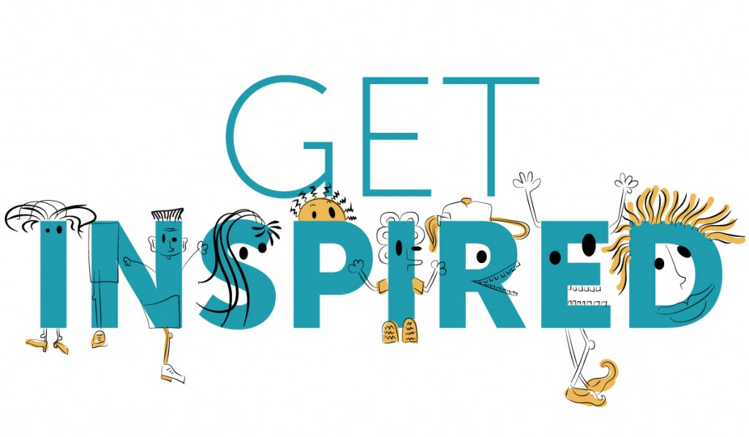
MySkool is an inspiration for schools, teachers, parents and students to excel in life. It is a message that ‘good is always appreciated.’ It is a push towards self motivation, an opportunity to see how others are growing and a chance to appreciate fellow human beings.

